Slide 1
System Programming
Process Management

Slide 2
Processes in Unix
Process: basic unit of execution
  Executing instance of a program
  Has a process ID (PID)
  Occurs in a hierarchy of processes (parents and children)
  Root is the init process
  Each process has its own state/context/memory
Shell commands dealing with processes: ps, top, kill, nice,…

Slide 3
Process Management
System calls dealing with:
  Creating a process
  Setting the program a process executes
  Waiting for a process to terminate
  Terminating a process
  Sending signals to a process
  Communicating between processes

Slide 4
Process Information
Process ID is just a number returned by
  getpid()
From shell, use ps to list processes with IDs
Every process has a parent whose ID is obtained by
  getppid()
Every process is a member of a group whose ID is obtained by
  getpgrp()

Slide 5
Process Creation
pid = fork()
Creates a new child process that is an exact copy of the current process
  Same program running at same location
  Same variable values
  Same open files
Only difference: child has a new PID
Returns 0 in the child process
Returns child’s PID in the parent process

Slide 6
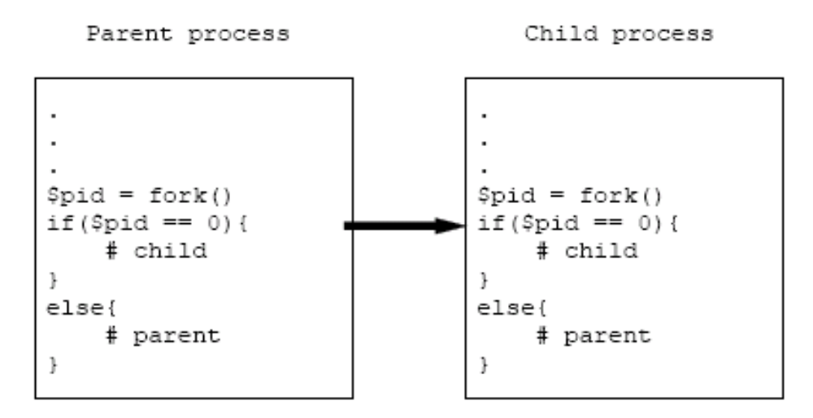
Process Creation (cont.)

Slide 7
Executing a Program
exec family of functions
  e.g. execlp(executable_name, arg0, arg1, …);
Replaces the current process with a new process image running the executable specified with the arguments listed
New process retains old PID and any open files
Other functions: execl, execle, execv, execvp, execve

Slide 8
Waiting for a Process to Terminate
pid = wait(&status)
  Suspends execution of the calling process until any child process terminates
  Returns PID of terminating child
  Puts exit status (int) of child in status
pid =waitpid(pid, &status, options)
Suspends execution of the calling process until a specific child terminates

Slide 9
Using fork/exec/wait Together
pid = fork();
if( pid == 0)
execl(“./program”, “program”, arg1, NULL);
else
pid = wait(& status);continue execution

Slide 10
Process Termination
exit(status)
Terminates the calling process
Closes all open file descriptors
Returns status to the parent process

Slide 11
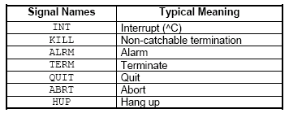
Signals
A signal is an interrupt sent to a process
An operating system supports a small number of signals, identified by signal names
Signals are caught by signal handlers

Slide 12
Sending Signals to a Process
Send a signal using kill function
  retval = kill(pid, signal)
Example
  kill(SIGINT, 1234);
  Sends an interrupt (signal) of type SIGINT
  Does not block sending process
  The process, whose ID is 1234, gets the signal.

Slide 13
Signal Handling
A function specified by signal handles the signal
  signal(signal, function)
  The function is called outside of normal execution order.
Example
  signal(SIGINT, func);
  A process which gets the signal SIGINT calls the function func
A process cannot handle SIGKILL

Slide 14
Inter-Process Communication (IPC)
Information passing between processes
Two basic paradigms
  Message passing: processes send information back and forth in messages/ packets
  Shared Memory: processes share a chunk of physical memory and read/ write data there to share that information

Slide 15
IPC with Pipes
Example of message passing
int fds[2];
retval =pipe(fds);
Creates two file descriptors (a pipe is a file), the first for reading, and the second for writing
How does another process connect to this pipe?

Slide 16
Basic Pipe Example
int fds[2]; char s[100]; else
retval =pipe(fds); write(fds[1],“hello”,6);
pid =fork();
if(pid ==0){read(fds[0], s, 100);
printf(“Read %s\ n”, s);}
NOTES:
data is written/read in order(FIFO)
reads block until there’s something to read
writes block if the pipe is full
closing the writing fd causes EOF to be read on the other end

